Slide 1

Progress Presentation
04-12-2024
Prepared by: Marie Joe Sawma To: Dr. Reed Maxwell

Slide 2
Objective
The objective is to match the simulated data to the observed data by varying parameters and building the prior distribution. Today, the focus is on hydraulic conductivity and its alignment with the observed data.

Slide 3
Part 1: Explanation of Approach

Slide 4
Collection of Data
Data was collected over a one-year period, starting on October 10, 2018, and ending on October 10, 2019, in the state of Nebraska. The AmeriFlux site for this data is US-Ne2.

Slide 5
Single Column : USNe -2
To be able to capture the range of Hydraulic conductivity effectively, we conducted five simulations in total. This approach was chosen to ensure the identification of pattern for the data.

Slide 6
Discussion of Soil Type : Hydraulic Conductivity
The range of hydraulic conductivity selected for the initial simulations were designed to account for the different types of soil present whether sandy, loam, clay, rock.

Slide 7
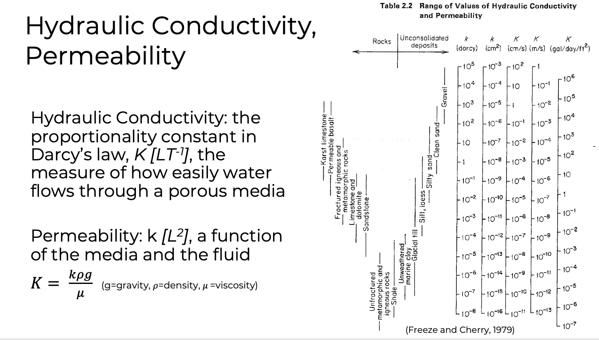
US Ne2 : Hydraulic Conductivity
The Hydraulic Conductivity that have been selected to run the simulations range between 10⁻¹³ and 1 m/s
The objective of running simulation on this big range is to assess the trend of the whole possible hydraulic conductivity through plotting . Moreover, the hydraulic conductivity with high values of error will be eliminated for the next round of simulation that will be more focusing on the range where the value of error are acceptable.

Slide 8
Simulation of Hydraulic Conductivity
For each simulation, the files were reviewed to ensure they completed successfully and did not encounter any errors.

Slide 9
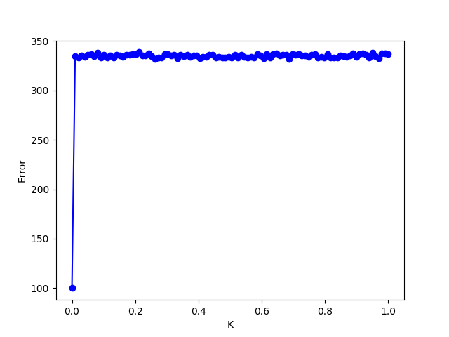
First Simulation : Hydraulic Conductivity
Range of the first simulation
Kmin = 3.6 x 10⁻¹⁰ m/hr
Kmax = 3600 m/hr

Slide 10
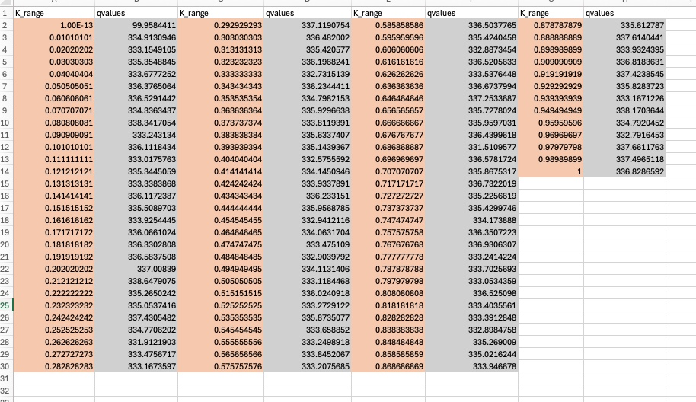
Range of Error For K
Lower Bound : 99.958
Upper Bound : 336.828
Focus on the hydraulic conductivity values between 1.00E-13 m/s and 0.01 m/s, as a pattern can be observed in this range of the graph while eliminate the other value when re-running the next simulation.

Slide 11
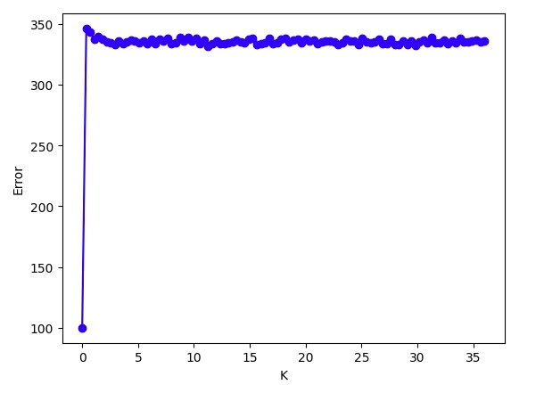
Second Simulation: Hydraulic Conductivity
Range of the second simulation
Kmin = 3.6 x 10⁻¹⁰ m/hr
Kmax = 36 m/hr

Slide 12
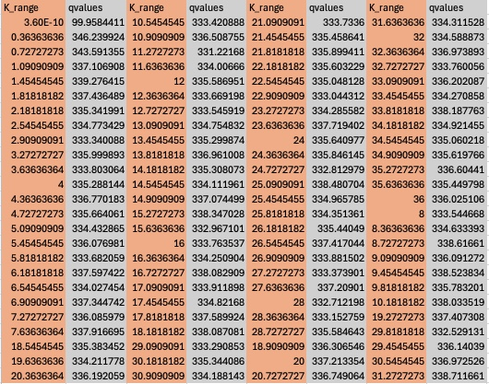
Range of Error For K
Focus on the hydraulic conductivity values between 1.00E-13 m/hr and 0.36 m/hr given that the error are still within the 300

Slide 13
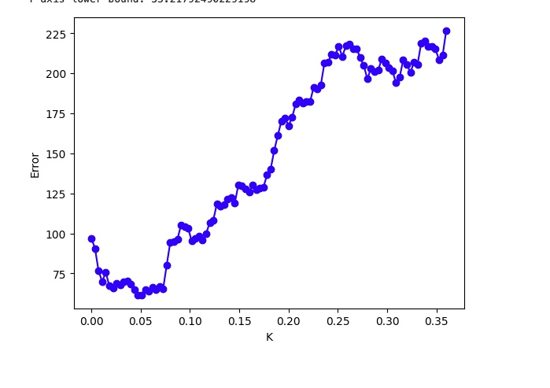
Third Simulation: Hydraulic Conductivity
Range of the third simulation
Kmin = 3.6 x 10⁻¹⁰ m/hr
Kmax = 0.36 m/hr

Slide 14
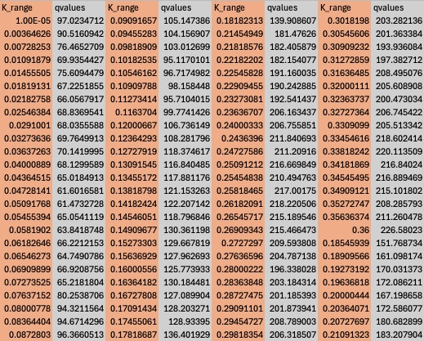
Range of Error For K
Focus on the hydraulic conductivity values between 1.00E-5 m/hr and 0.005 m/hr

Slide 15
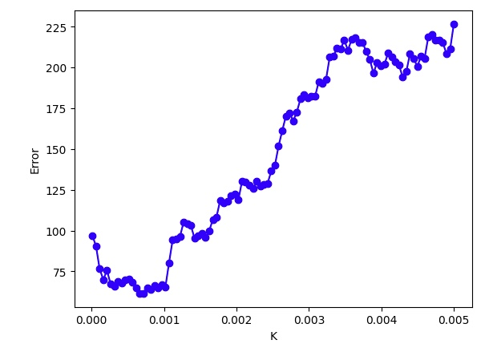
Fourth Simulation: Hydraulic Conductivity
Range of the fourth simulation
Kmin = 0.00001 m/hr
Kmax = 0.005 m/hr

Slide 16
Range of Error For K
Focus on the hydraulic conductivity values between 1.00E-5 m/hr and 0.1 m/hr
Additional notes are written on my notebook

Slide 17
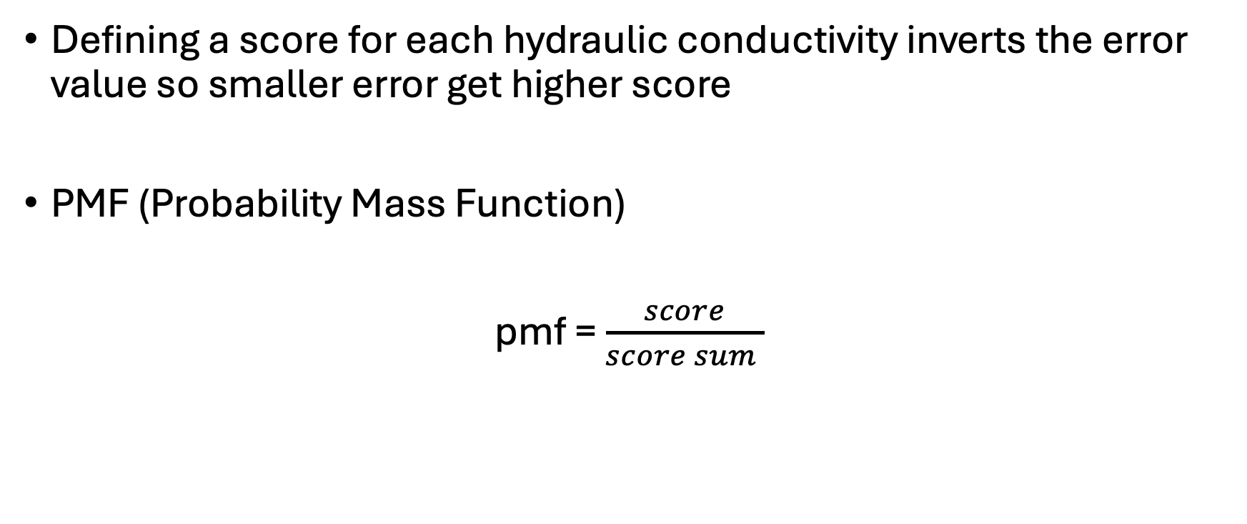
Simulation: Prior Distribution
Defining a score for each hydraulic conductivity inverts the error value so smaller error get higher score
PMF (Probability Mass Function)
pmf = $\frac{score}{score sum }$

Slide 18
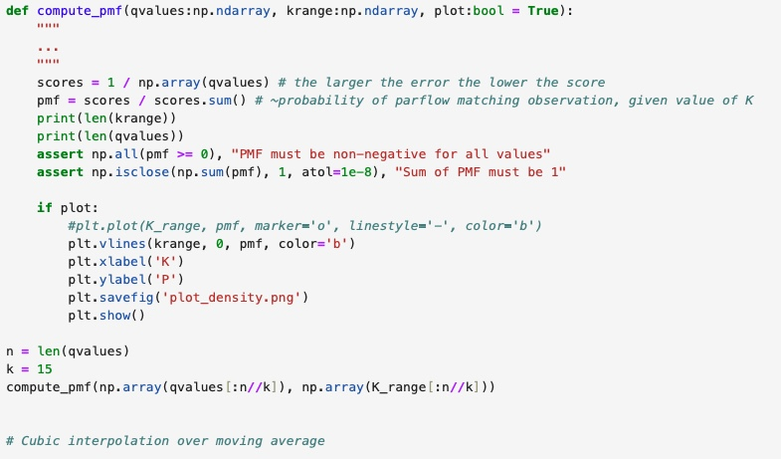
Prior Distribution Code
More notes are written on my notebook

Slide 19
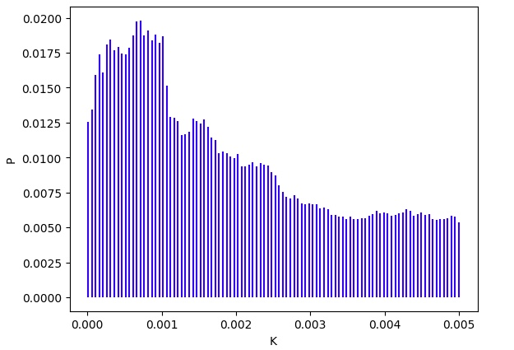
Fourth Simulation: Prior Distribution

Slide 20
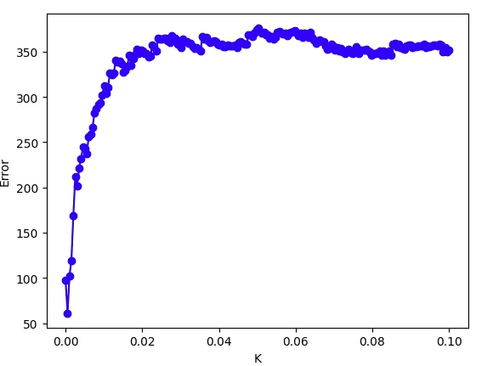
Fifth Simulation: Hydraulic Conductivity
Kmin = 0.00001 m/hr
Kmax = 0.1 m/hr
simulation : 200

Slide 21
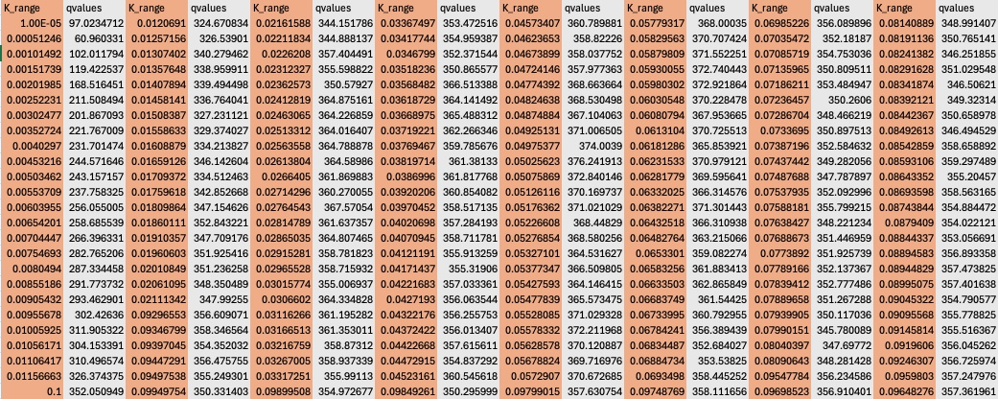
Range of Error For K
Lower Bound : 99.958
Upper Bound : 336.828

Slide 22
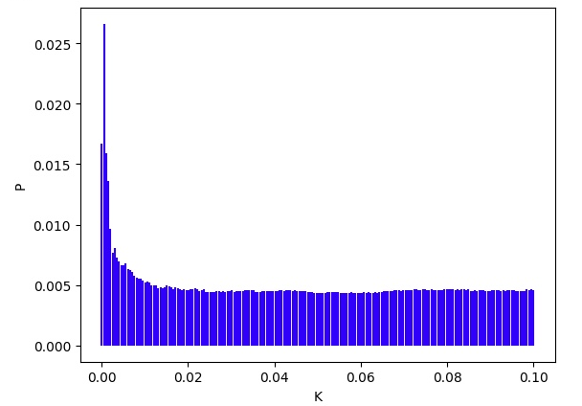
Prior Distribution

Slide 23
First Simulation
Second Simulation
Third Simulation
Fourth Simulation

Slide 24
Prior Distribution
Fourth Simulation
Fifth Simulation

Slide 25
Refining The Prior Distribution
To refine the prior distribution for hydraulic conductivity, it is essential to consider the results of the fourth and the fifth simulation where the error between the observation and the simulated data has been decreased significantly.
After determining the range of the hydraulic conductivity, we will increase the density of values withing the interval selected by running more simulations within this range.
Highlighted notes

Slide 26
Discussion of Baseline Condition
The prior distribution for hydraulic conductivity has been generated based on specific conditions, namely porosity and a define water table depth. The baseline conditions play a critical role in shaping the resulting prior distribution. If these conditions were altered –such as modifying the porosity or selecting water table depth – the resulting prior distribution for k could differ significantly.

Slide 27
Discussion of Soil Type
When discussing type of soil, it means that the focus on the environmental soil (bare soil , vegetated soil , soil with a specific land use) .
Highlighted notes

Slide 28
Discussion of Porosity for Baseline Condition
When starting the simulation to explore the impact of porosity , the baseline of hydraulic conductivity and water table depth should be the same as the baseline condition to ensure that any observed variations in the error is attributed solely to change in porosity .
Highlighted notes

Slide 29
Proposed Approach
Run the hydraulic conductivity simulation on a different HUC to determine if the pattern remains consistent but with a translation or shift in its behavior .
Highlighted notes

